Slide 1
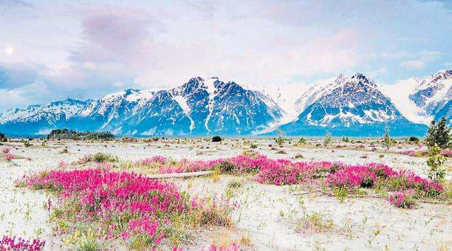
Tundra

Slide 2
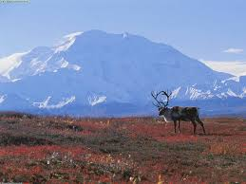
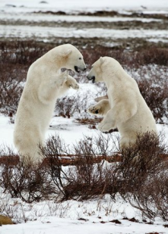
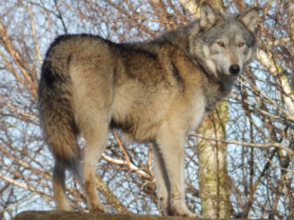
ANIMAL SPECIES
Caribous live in the trundra of Alaska
Polar bear lives in the trundra of Canada
Wolf lives in the trundra of Rusia

Slide 3
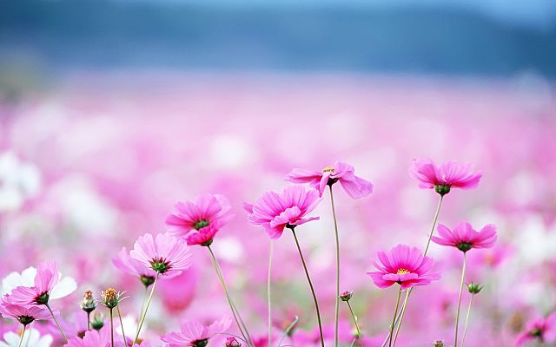
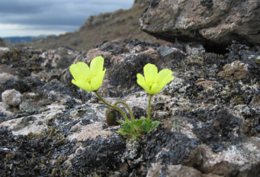
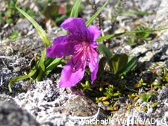
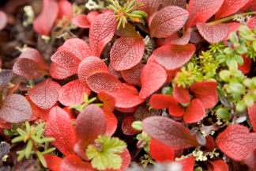
PLANT SPECIES
This plant lives in Artic Tundra
This plant lives in Alaska Tundra
This plant lives in Artic Tundra

Slide 4
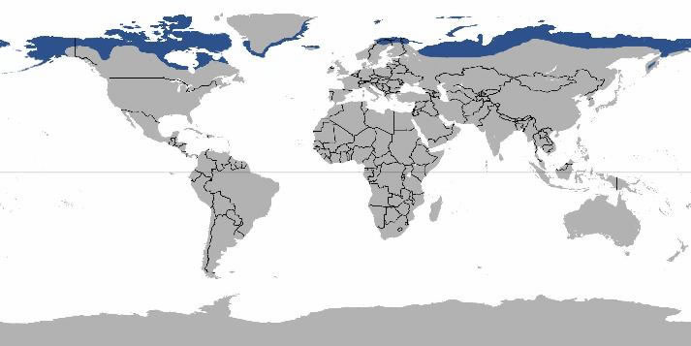
The locating of the tundra

Slide 5
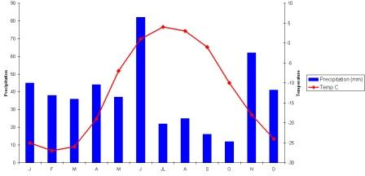
Climate
Polar time of climate is found mainly north of the Arctic circle in the northern hemisphere.
In the southern hemisphere, Antarctica is the greatest single stretch of ice caps, always snow covered.

Slide 6
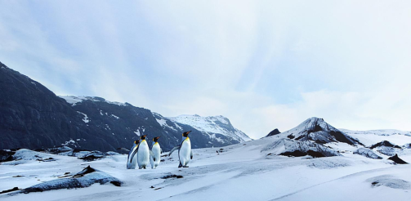
Tundra ecosystem
The Tundra plays a large role in the temperature regulation of the planet. As warm air rises from the tropical zone it is cooled in the Tundra causing it to sink back down to the equator. Without this system climate would change drastically around the world.

Slide 7
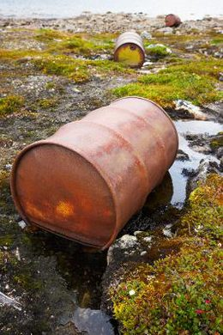
Problems
People worry that pollution from mines and rigs may ruin the fragile ecosystem. A caribou migration route was interrupted by construction

Slide 8
THANK YOU FOR YOUR ATENTION
The authors: Naroa , Alba , Marina and Carlos A
.

