Slide 1
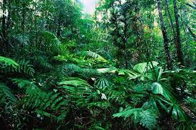
RAIN FOREST
Tropical rain forests are home to some of the world’s greatest treasures: countless species of plants and animals, oil, rubber, precious metals, and much, much more. Many of these riches already benefit us humans. They contribute to medicines, foods, and industrial products.

Slide 2
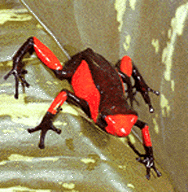
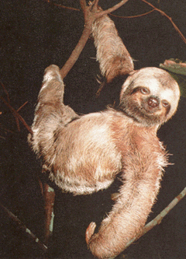
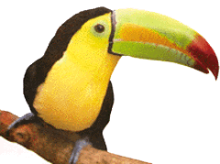
ANIMALS
TOUCAN
There are about 40 different kinds of toucans.
They have short and thick necks.
Toucans are distinguished by large, colorful, yet lightweight bills.
POUSION
ARROW FROG
Poison-arrow frogs are social frogs found in Central and South America. They are known by their bright colors which warn other animals that they are poisonous.
SLOTH
Sloths are extremely slow-moving mammals found in the rainforest canopies of Central and South America.

Slide 3
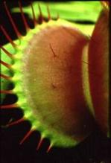
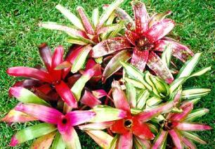
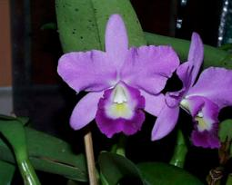
PLANTS
CARNIVOURUS PLANT
Some plants are adapted to obtain nutrients from animal matter. The best known of these is probably the Venus fly trap, but more impressive is the pitcher plant Nepenthes rafflesiana, found in southeast Asia.
BROMELIADS
Bromeliads are related to the pineapple family.
ORCHIDS
Orchids comprise one of the most abundant and varied of flowering plant families. There are over 20,000 known species and orchids are especially common in moist tropical regions.

Slide 4
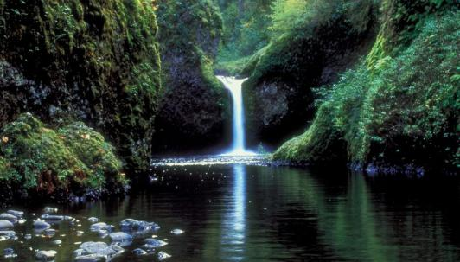
CLIMATE
Tropical rainforests are located North and South of the Equator between the Tropic of Cancer and the Tropic of Capricorn. They have a warm and humid climate with lots of rainfall.

Slide 5
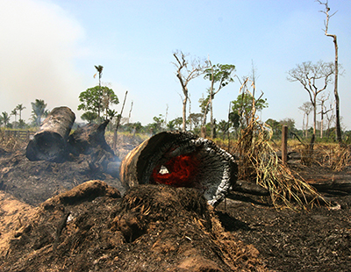
PROBLEMS
The biggest danger to rainforests is deforestation.Forests cover about 30% of the planet, but deforestation is clearing these essential habitats on a massive scale.

Slide 6
https://youtu.be/vy2UENSgZ6A

Slide 7
BYE BYE
Created by:
Javier Sarobe
Oscar Tuñón
Julen Cemborain
Sergio Mendoza

