Slide 1
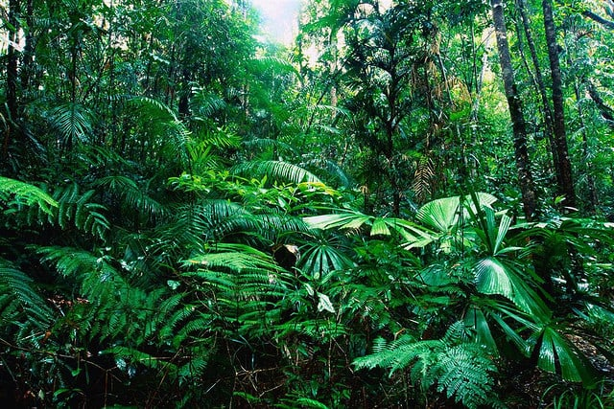
Tropical rain forest

Slide 2
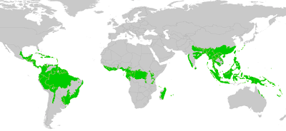
We can find it in...
South America,
part of Africa,
part of Asia and a bit of Oceania.

Slide 3
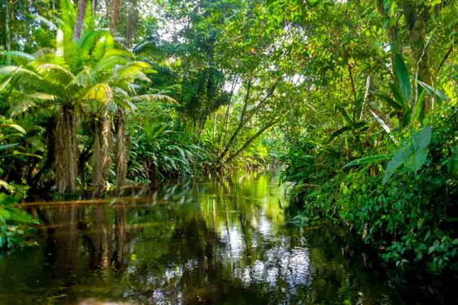
How is it?
Temperatures don’t change a lot between the night and the day.
The environment is pretty and wet.
Tropical rainforest is home for the half animals and plants species on Earth.

Slide 4
Why is important ?
Tropical rain forest is important because they provide oxigen.
And because they help to mantain global weather
patterns and rain and the water that evaporate on trees fall as rain in other areas.

Slide 5
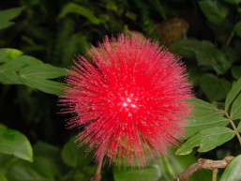
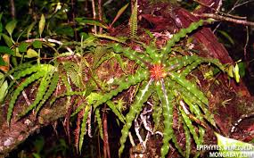
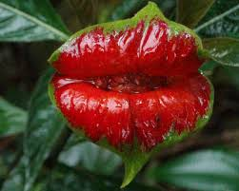
Plants
Epiphytes are plants that live on the surface of other plants. They often grow on trees to take more sunlight.
Trees usually live for 50 - 100 years. Tropical rainforests are so big that they are divided into four zones.

Slide 6
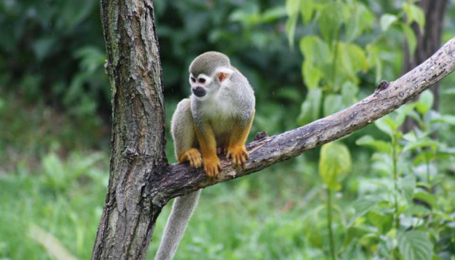
Animals
Scientists believe that there a big diversity of animals in tropical rainforests because they are one of the oldest ecosystems on earth.
Animals are adapted specially live in this environment.
For example:
New world monkeys
have a tail that curl
around the braches of
trees to hold into the
trees.

Slide 7
Problematic
DEFORESTATION:
Statistics show 10.4million hectares of rainforest are destroyed every year.
WEATHER CHANGE:
A temperature change of one or two degrees can dry out the rainforest and afect the many plants and animals living in there.

Slide 8
Bye bye
SANDRA, ROCÍO,SARA Y ALTHEA

