Slide 1
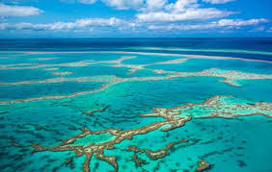
THE OCEAN
Notes:
1

Slide 2
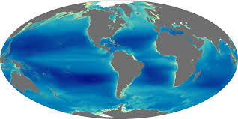
LOCATION
The marine biome is the biggest biome in the world! It covers the 70% of the earth. It inculdes main oceans: the Pacific, Atlantic, Indian, Artic and Southern ocean.
Notes:
2

Slide 3
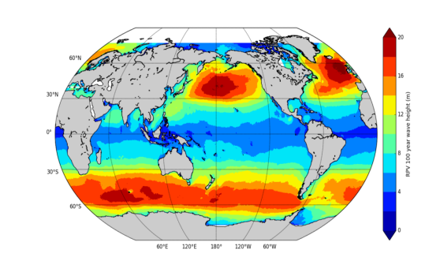
WEATHER
The ocean is a big influence on weather. The weather may be sunny or cloudy, especially in Santa Barbara because the ocean is right outside our back door.
Notes:
3

Slide 4
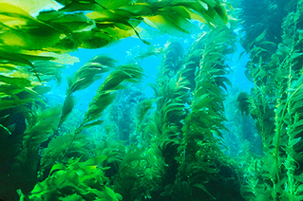
PLANTS
Over 1 million species of plants and animals have been discovered in the oceans, and scientists say there may be as many 9 million species haven’t found yet.
Notes:
4

Slide 5
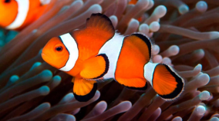
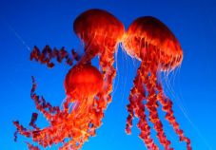
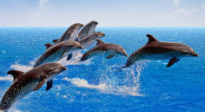
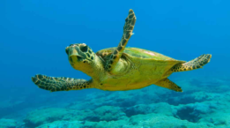
ANIMALS
The Earth’s oceans are home for the most of the planet’s biodiversity. Here we can find: mollusks, fishes, whales, crustaceans, bacterias, fungies, sea anemones and many other sea animals. Many animals have special adaptions to handle this difficult enviornment.

Slide 6
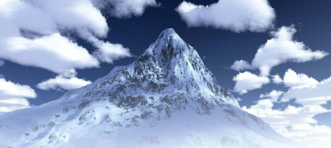
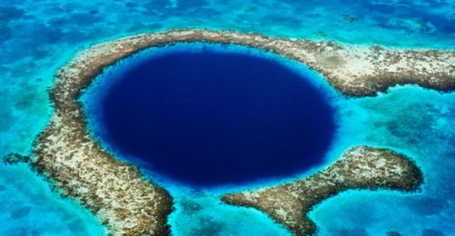
FACT N1
The deepest point on the ocean is the Mariana Trench and, is longer than The Mountain Everest! The Mariana Trench is about 10,000ms deep.

Slide 7
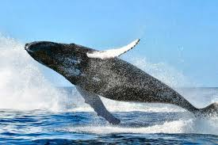
FACT N2
The biggest animal of the ocean is the Blue Whale. It can be over 30 metres long. Blue Whales are so large that a small person could crawl through their main arteries, and 20 people could stand on their tongue!

Slide 8
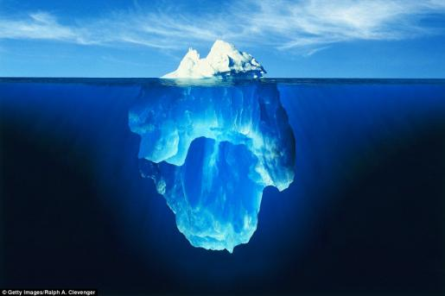
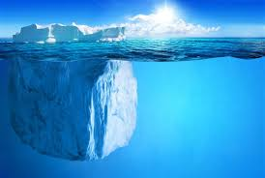
FACT N3
The icebergs are pieces of ice that formed on land and floats in oceans or lakes. We can find them on The North Atlantic.

Slide 9
END BY:
DANIELA
ESTER
MARÍA
NAZARENA

