Slide 1
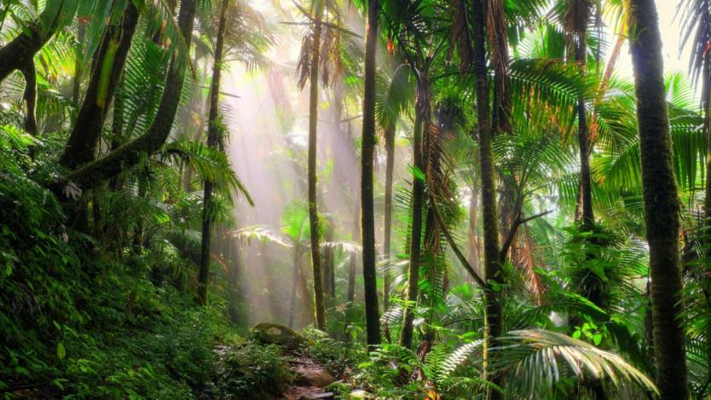
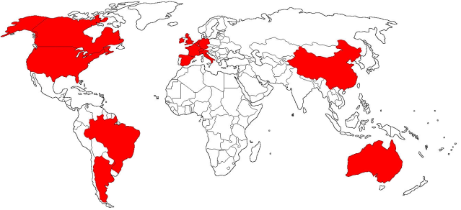
THE JUNGLE

Slide 2
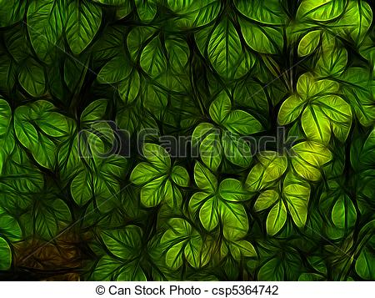
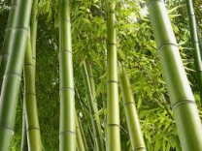
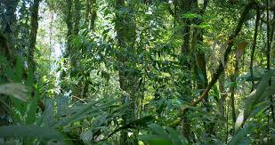
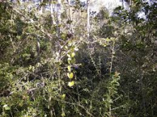
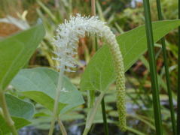
THE PLANTS
Bamboo Plant are used to make furniture and clothing and also act as a part of some animal's diets. Bamboo plants can flower from as many as 65-120 years. Lizards Tongue Bush grows very fast all over the jungle. Its slimy leaves give it its unique name.

Slide 3
TEMPERATURE
•Cold – between 10-20°C (50-67°F)
•Warm – between 21-25°C (68-77°F)5
•Hot – between 26-31°C (78-88°F)

Slide 4
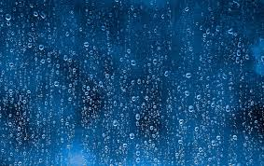
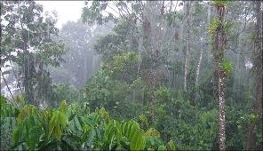
RAINFALL
•Mostly Fine – under 60 mm/month
•Showers – between 60 – 250 mm/month
•Heavy Rain – 250 mm/month and over
The Amazon Jungle lies right on the equator so it receives a lot of sunlight making the climate very warm and humid. It also receives a lot of rainfall making the combination of sunlight and water. During the day, the temperature can get up to 33°C around mid-afternoon, and at night it cools down to around 18°C.

Slide 5
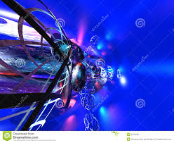
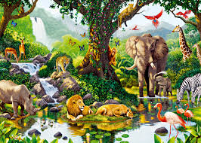
WHY IS THE JUNGLE IMPORTANT ?
The sheer fact that they’re home to more than half of the planet’s species of plant and animal life should be reason enough to understand why rainforests are important resources.

Slide 6
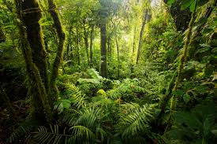
PROBLEMS OF THE JUNGLE
Yet still these total ecosystems are under constant threat of destruction. Sadly, human ignorance has led to greed.

Slide 7
video
https://youtu.be/I9KdodlJYbY

Slide 8
END
MARTIN
BY:
BEÑAT
DANI
ARTUR

