Slide 1
GRASSLANDS

Slide 2
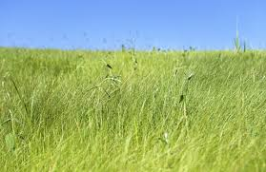
What are grasslands
Grasslands are wide expanses of land filled with low growing plants such as grasses and wildflowers.

Slide 3
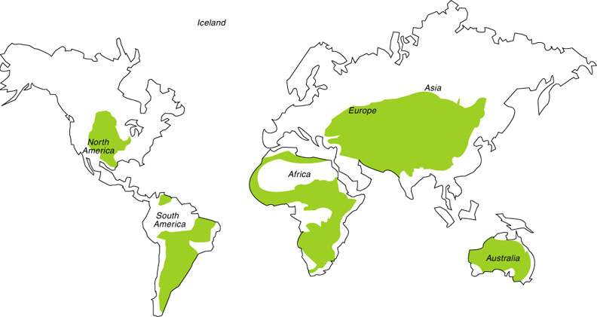
Where are the major world grasslands?
Grasslands are generally located between deserts and forests.

Slide 4
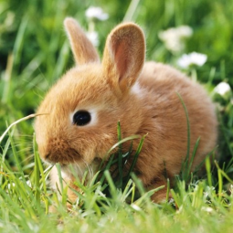
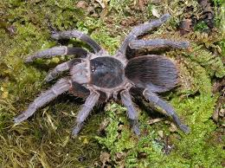
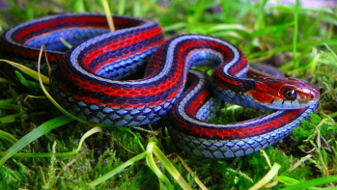
Animals
A variety of animals live in the grasslands. These include prairie dogs, wolves, turkeys, eagles, weasels, bobcats, foxes, and geese. A lot of smaller animals hide down in the grasses such as snakes, mice, and rabbits.

Slide 5
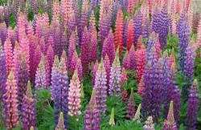
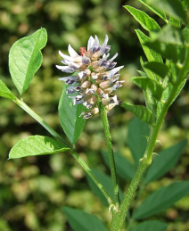
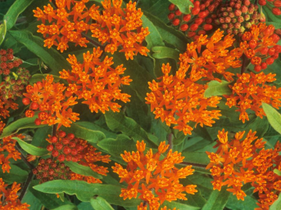
PLANTS
Different kinds of grass grow in different areas of the grasslands. In wetter grasslands, there are tall grasses that can grow up to six feet high. In dryer areas the grasses grow shorter, maybe only a foot or two tall.

Slide 6
THE CLIMATE
Temperate grasslands have hot summers and cold winters. They typically have between 10 and 35 inches of precipitation a year, much of it occurring in the late spring and early summer.

Slide 7
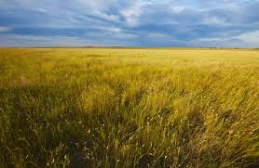
IMPORTANT ECOSYSTEM
Nearly 40 percent of the earth's land surface is composed of grassland ecosystems. Grasslands throughout the world are essential to the survival of plant, animal, and bird species.

Slide 8
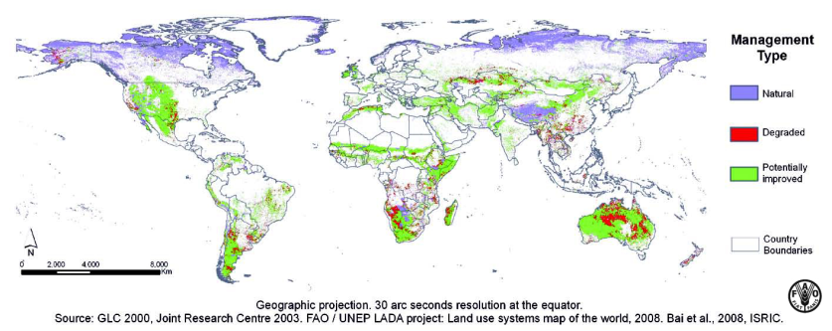
PROBLEMS
Wildfires can play an important role in the biodiversity of the grasslands. Scientists believe that occasional fires help to rid the land of old grasses and allow for new grasses to grow, bringing new life to the area.

Slide 9
By
Eric
Cesar
David Macai
Andres

