Slide 1
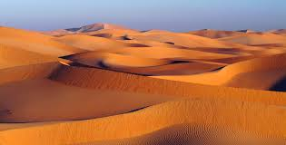
DESERT BIOME
The desert is important because it covers about a fifth of the earth's surface! There are both hot and cold deserts. Antarctica is the largest desert in the world, while the Sahara in Africa is the largest of the hot deserts
Notes:
1

Slide 2
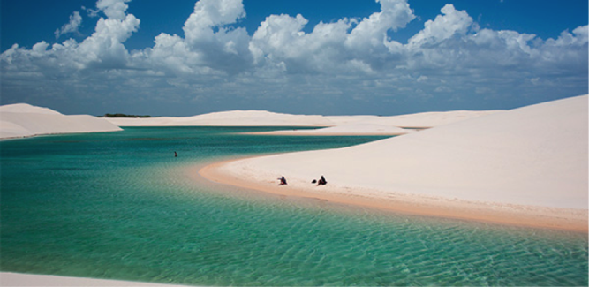
Weather
Weather is not the same in all deserts. Rain is often light, or in short concentrated bursts. Sometimes the rain evaporates before even hitting the ground. This is the reason for the dry characteristic of this type of desert.
Notes:
2

Slide 3
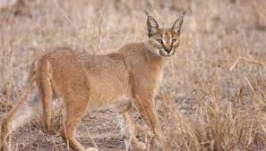
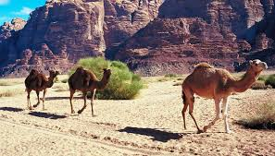
Desert animals
Deserts are home to many reptiles, insects, birds, and small mammals.
Australia's bilby and the kangaroo mice of North America are just a few examples of small mammals that live in the desert
Notes:
3

Slide 4
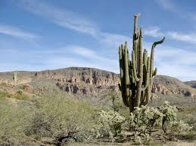
Desert plants
Deserts plants have many adaptations to survive . Some plants have seeds that can stay in the sand for a long time, until there is enough rain for them to grow. In hot deserts, you'll often find Cacti. Cacti are great at storing water.
Notes:
4

Slide 5
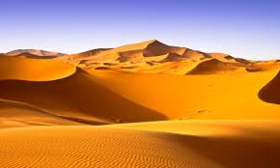
THE END
BY: Gabriel Azuaje ,Jean Paul, Pablo Trinidad
and Carlos López
Notes:
5

