Slide 1
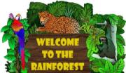
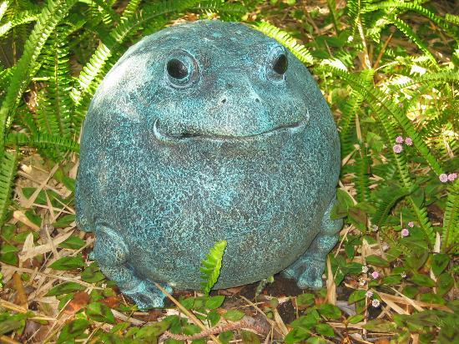
RAINFOREST

Slide 2
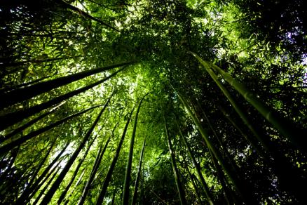
WHAT IS THE RAINFOREST?
Tropical rainforests are forests with tall trees, warm climates, and lots of rain. In some rainforests it rains more than one inch nearly every day of the year!
Rainforests are found in Africa, Asia, Australia, and Central and South America. The largest rainforest in the world is the Amazon rainforest in South America.
From: http://www.glogster.com/cdutzer/tropical-rainforest/g-6n7h3sb4smn45qgen8ttva0

Slide 3
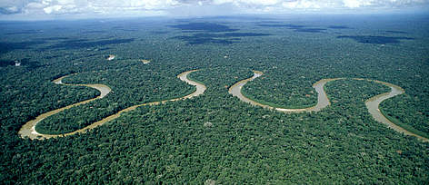
CLIMATE
Tropical climates are found in areas that lie close to the equator. Here the sun shines intensely. Within tropical climates, there are three groups: tropical wet; tropical wet and dry; and tropical monsoon. Tropical wet regions, also known as rain forests, have the most predictable weather on earth.You can expect lots of rain, warm nights and hot days. The seasons change only slightly.
http://wwf.panda.org/what_we_do/where_we_work/amazon/about_the_amazon/why_amazon_important/

Slide 4
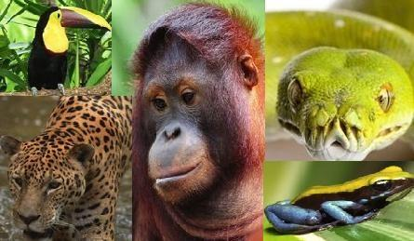
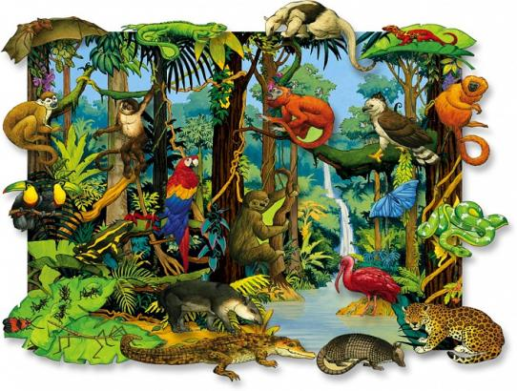
ANIMALS
Africa Forest Elephant
Bengal Tiger
Chimpanzee
Common Palm Civet or Musang
Dawn Bat
Golden Lion Tamarin
Harpy Eagle
Jambu Fruit Dove
King Cobra
Kinkajou
Linn's Sloth
Orangutan
Proboscis Monkey
Red-shanked Douc Langur
Silvery Gibbon
Slender Loris
Sumatran Rhinoceros
Toco Toucan
Vampire Bat
Wagler's Pit Viper

Slide 5
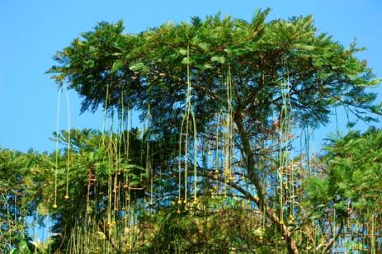
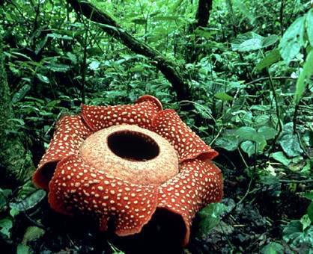
PLANTS
Bengal bamboo
Bougainvillea
Curare
Coconut tree
Dourain
Jambu
Kapok tree
Mangrove
Strangler figg
Tualang
Mangroves
Rafflesia Flower

Slide 6
Authors: Sergio, David, Pablo and Andrés.

