Slide 1
ARTIC

Slide 2
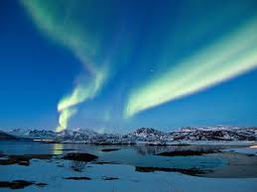
Geography
The Arctic region is found in the northernmost part of Earth.
As well as the Artic Ocean , the Artic region is made up of parts of Russia, Greenland, Canada, USA, Norway, Iceland, Sweden and Finland.

Slide 3
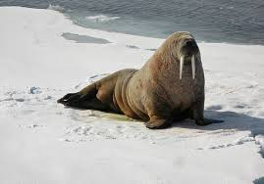
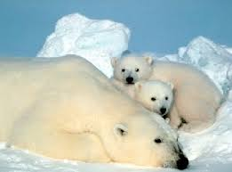
Animals
A number of different types of animals make their home in the arctic, including polar bears, wolverines, squirrels, birds, walrus and seals.

Slide 4
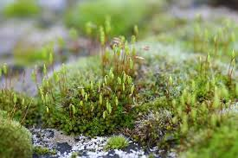
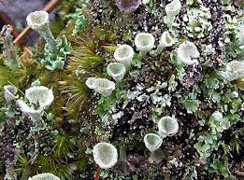
Plants
Small shrubs can grow in warmer parts of the Arctic, as well as various herbs, mosses and lichens.

Slide 5
Temperature
The coldest recorded temperature in the Arctic is around −68 °C (−90 °F).

Slide 6
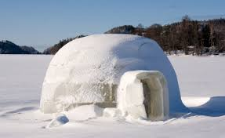
Houses
Living in the frozen tundra made it very hard to find any building materials so they built their homes with the only abundant material they had around them which was snow.
The Eskimos created their homes out of snow and ice and called them igloos.

Slide 7
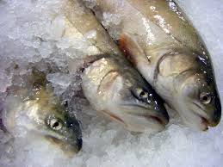
Food
The Arctic tribes eat a lot of animals. They include seals, sea lions, narwhals, reindeer , and much more.

Slide 8
Authors
Jeremy Melgarejo
Jon Zarranz
Martin Pereyra
Asier Tabar

